Slide 1


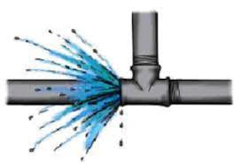




S.A.P.D.J. Pathshala’s
Walchand Institute of Technology
An Autonomous Institute
Comprehensive Inspection and Analysis of Water Supply
Pranita Annaldas
Ketaki Bidkar
Rumesha Khan
Samruddhi Chobharkar
Padamaja Alase
Leakage Don’t Worry Water Line Defenders got it

Slide 2

Content
Idea of the project
Background of Project
Methodology
System Architecture
Hardware and Software required
Technology Stack
Work Distribution
References

Slide 3

Idea of the project:
Water resources are depleting globally, highlighting the need for efficient water management.
A crucial aspect is reducing water leakages and improving the water distribution network.
Challenges include conducting through inspections of 100 - 200mm diameter water supply distribution lines.
Solution involves a cloud-based dashboard for data analytics, visualization, and report generation.
Benefits include enhanced service delivery, improved repair efficiency, and reduced water leakage.
Immediate action on contamination complaints and early leak detection are priorities.
Streamlining pipeline condition assessment and facilitating GIS mapping are essential.
Overcoming deployment constraints involving live inspections, image analytics, and laser projections is crucial for accurate assessment.

Slide 4

Background of Project :
Literary survey :
Collect information about the Water supply and Distribution lines in Solapur.
Existing system:
Supervisiory Control And Data Acquisition (SCADA System).
Limitations of SCADA system:
Existing systems struggle to scale with increasing data volumes and device connections.
Limited ability to process real-time data efficiently.
Basic visualization and analytics capabilities hinder advanced analysis.
Lack of mobile-friendly interfaces restricts remote monitoring.
Limited support for AI, ML, and IoT hampers automation potential.

Slide 5

Methodology :
Prototype Functionality:
Incorporates water flow measuring sensors across the distribution pipeline.
Sensors collect real-time data as water flows.
Data transmitted to the aggregation node, serving as the main communication hub.
The data is then trained using the Machine Learning Analysis and the accuracy and precision , Mean Absolute error, etc are analysed.
Complaint Management :
Complaint provider feature available on website/dashboard.
Engineers investigate complaints and take necessary actions.
User Access:
Cloud-based dashboard and mobile application developed.
Allows users to monitor sensor data in real-time from anywhere.

Slide 6

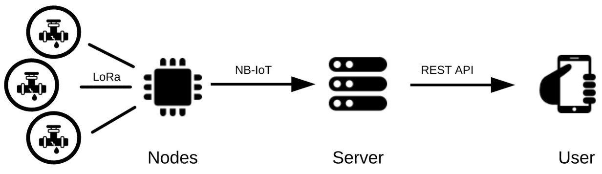
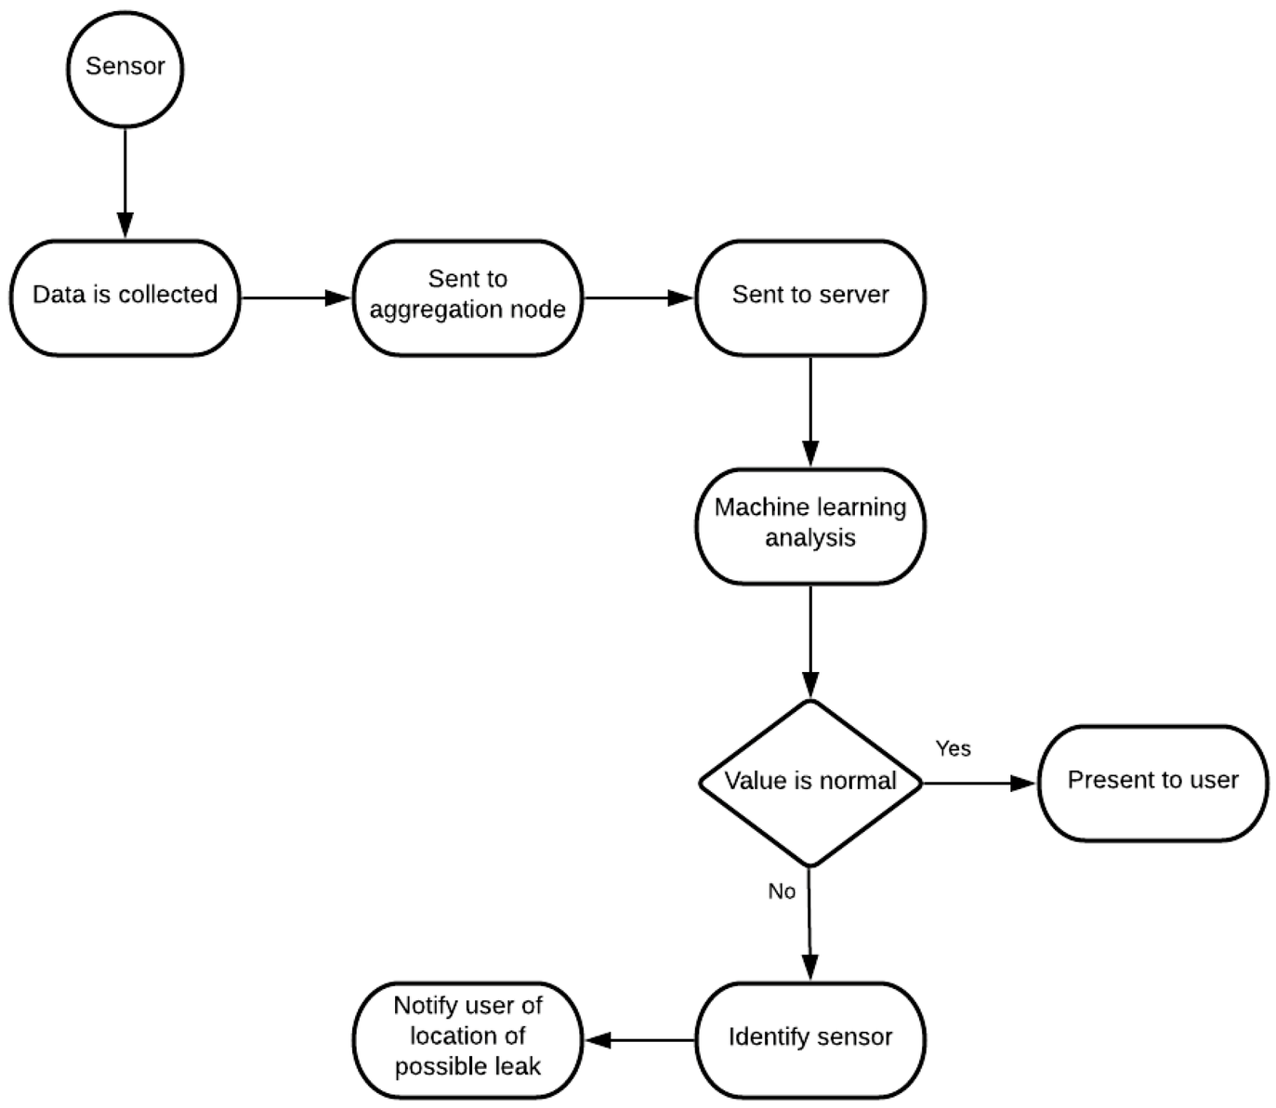
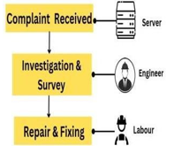
System Architechture :
System Logic :
Contamination
Complaint Flow :

Slide 7
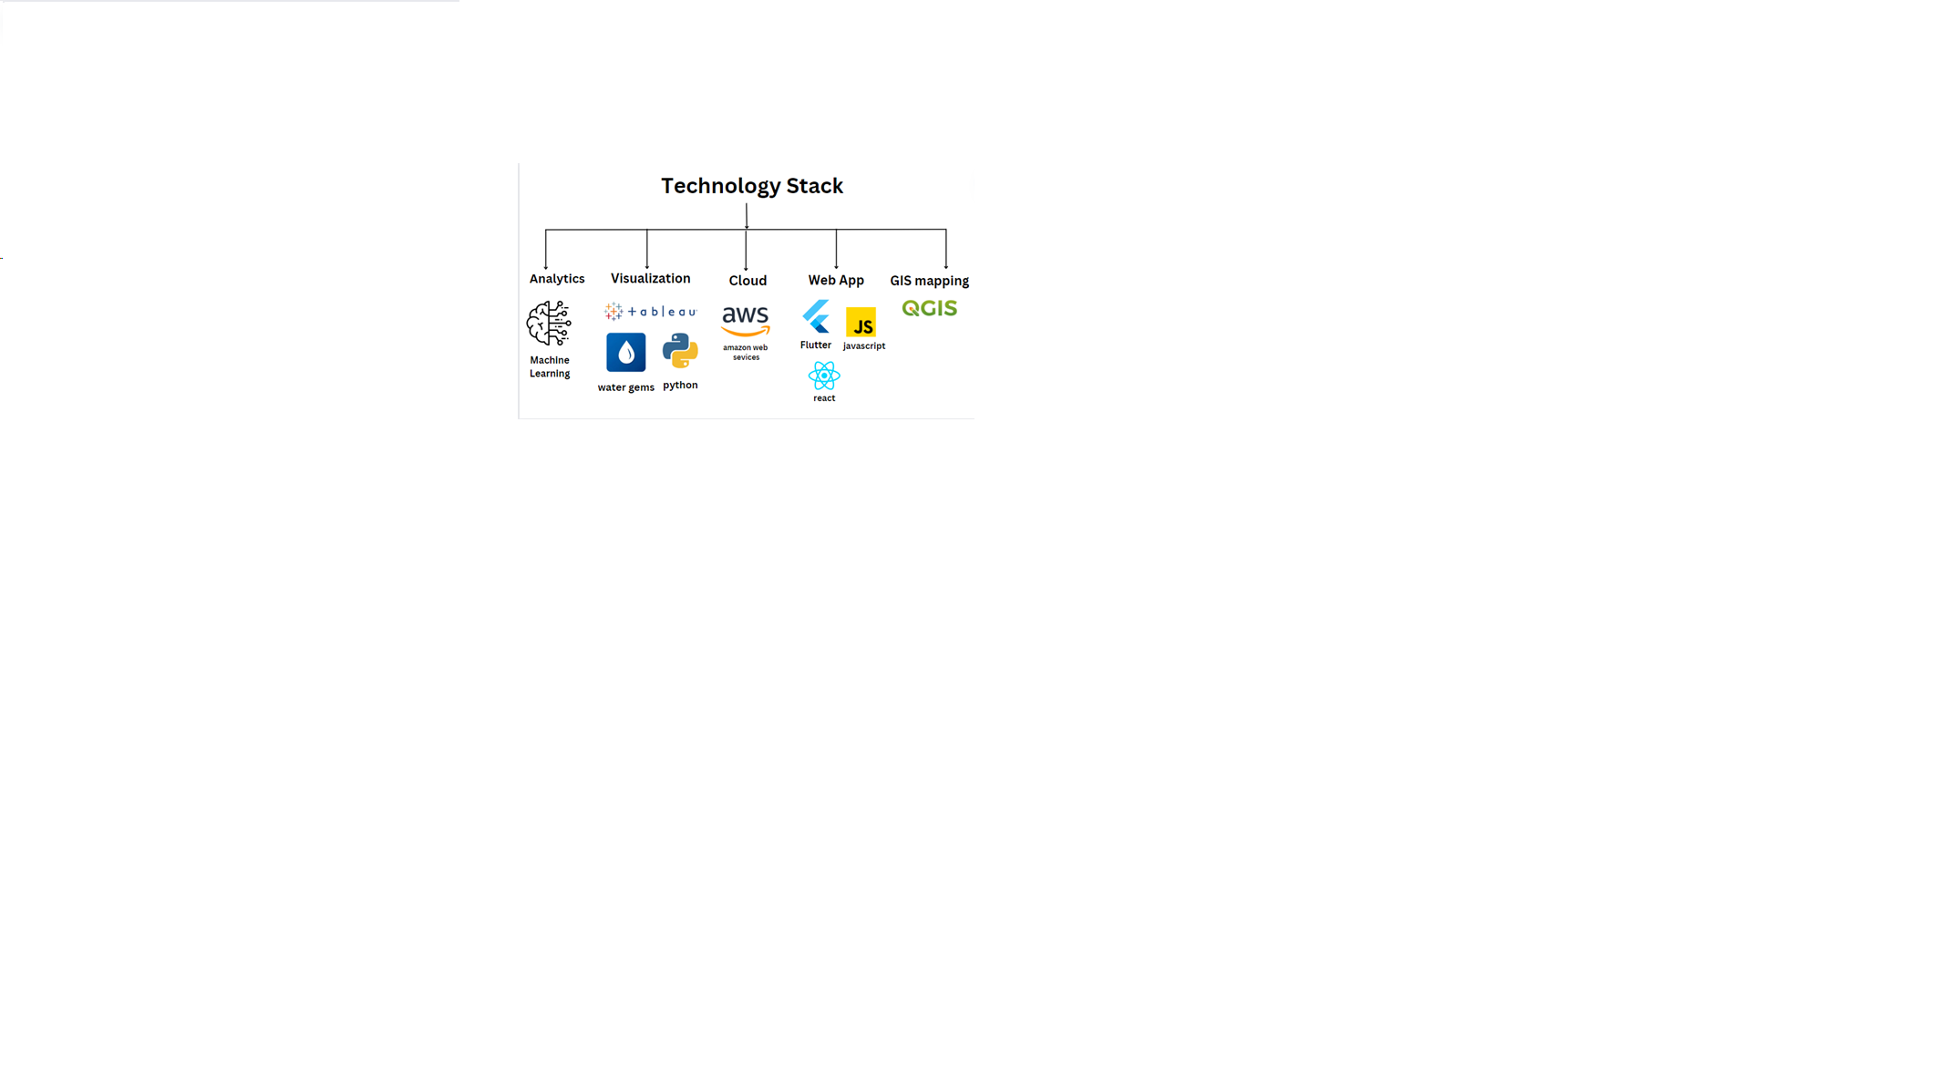

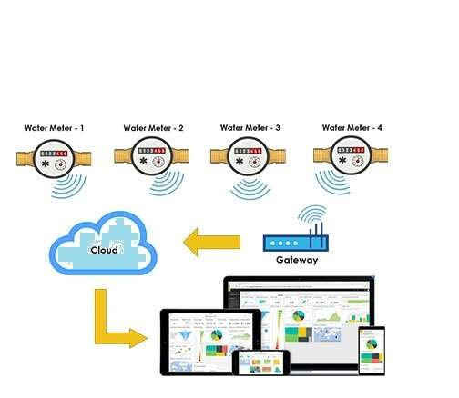
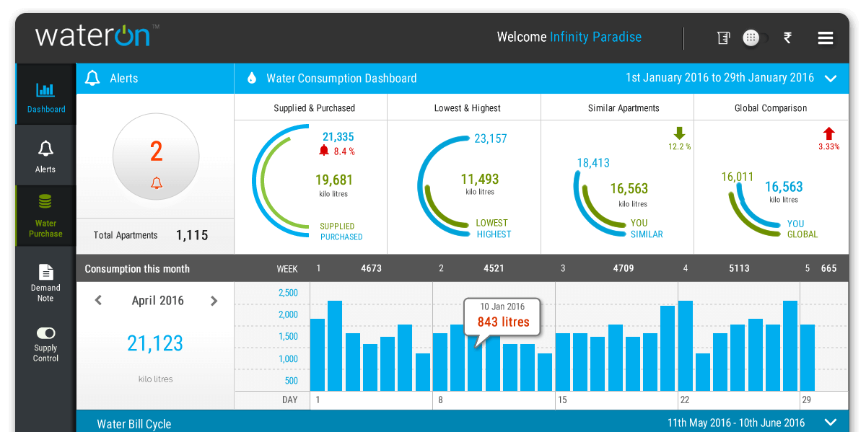
Software Required :
TensorFlow
PyTorch
scikit-learn
IBM Watson Studio
Tableau Online
AWS Command line Interface

Slide 8

Work Distribution :
Pranita :
Machine Learning Analysis, Logic Implementation for one on one data collection for Dashboard creation, Real Time Dashboard, GIS Mapping.
Ketaki :
Real time Data Collection from Municipal Corporation, Machine Learning Analysis, Real Time Dashboard, GIS Mapping.
Rumesha :
Logic Implementation for one on one data collection for Dashboard creation, Real Time Dashboard, Website creation.
Samruddhi:
Logic Implementation for one on one data collection for Dashboard creation, Real Time Dashboard, Website creation, GIS Mapping.
Padamaja :
Logic Implementation for one on one data collection for Dashboard creation, Real Time Dashboard, Website creation, GIS Mapping.
References :
https://www.mdpi.com/2624-831X/1/2/26
www.google.com
www.wikipedia.com
https://www.myscada.org/
https://chat.openai.com/

Slide 9


Question and Answe﻿r...
Thank you

